Slide 1
Unit Testing with JUnit
Trainer: Le Hai Duong

Slide 2
Agenda
Quality
Software Testing
Unit Testing
JUnit
Advance features: Stub & Mock

Slide 3
Course Objectives
After the end of the course, you will have acquired sufficient knowledge to:
Understand Unit Test concepts and methodologies
Implement Unit Tests with JUnit
Your friend
Notes:
Make unit testing your friend and get along with it

Slide 4
Prerequisites
To get the most out of the course, you should have:
Knowledge of OOP
Java Fundamental
Eclipse
Notes:
What is a class?
Understand some concepts: object, instance
How polymorphism is implemented in Java?

Slide 5
Further References
http://xunitpatterns.com/Test%20Double.html
Quality Concepts:
http://asq.org/learn-about-quality/basic-concepts.html
JUnit
https://junit.org/junit4/
Stub & Mock
http://spring.io/blog/2007/01/15/unit-testing-with-stubs-and-mocks/
http://xunitpatterns.com/Test%20Double.html
Test Driven Development
https://www.guru99.com/test-driven-development.html
https://en.wikipedia.org/wiki/Test-driven_development
https://martinfowler.com/articles/practical-test-pyramid.html

Slide 6
Quality

Slide 7


Product / Service Quality
Think about:
Products you buy
Services you use
Notes:
Your cell phone gets boot loop
Weak 3G / 4G signal so you could not access internet

Slide 8
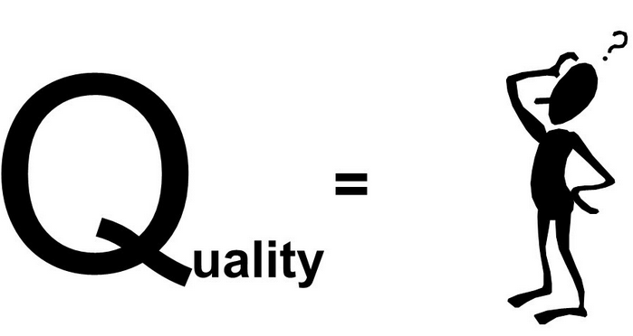
What is Quality?
Outcome of products / services
Conform to requirements and satisfy customers
Figure 1: What is Quality?

Slide 9
Software Testing

Slide 10
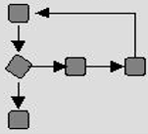
Software Testing Methods
Black box
Input
Output
White box
Input
Output
Figure 2: Comparison among Black-box & White-box Tests
Notes:
Black box testing – application interface, internal module interface, input / output description
White box testing – function executed and checked

Slide 11
Software Testing Levels
Time
Unit Testing
Integration Testing
System Testing
Acceptance Testing
Complex
Figure 3: Levels of Software Testing
Notes:
http://agile.csc.ncsu.edu/SEMaterials/BlackBox.pdf - page 38
Unit Testing - White box testing
Integration testing - Black- and white-box testing
System testing - Black- and white-box testing
Acceptance testing - Black-box testing
Regression testing - Black- and white-box testing (maintenance)

Slide 12
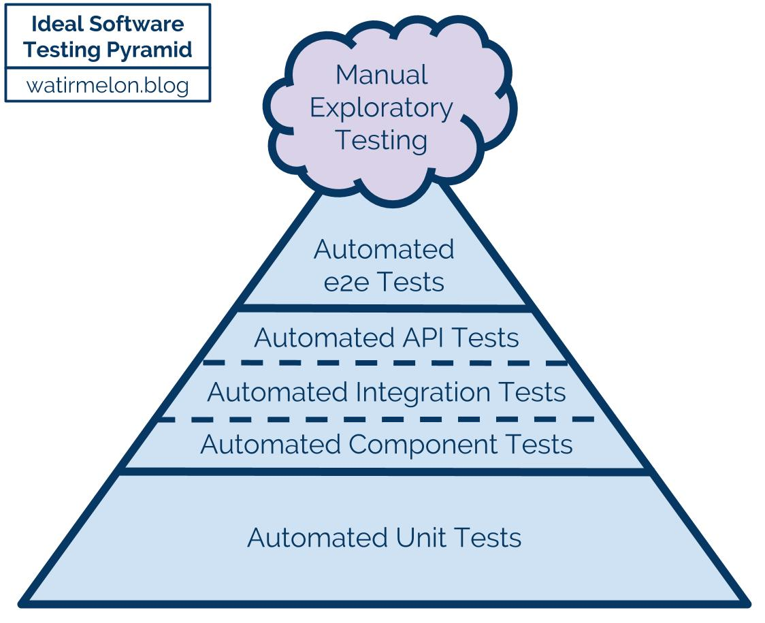
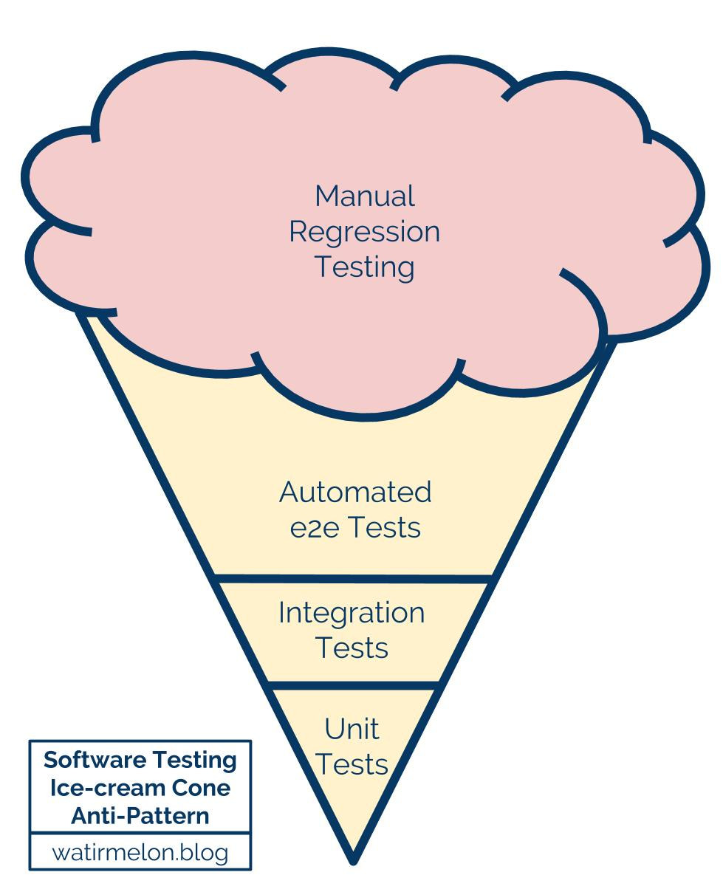
Testing Pyramids & Ice-Cream Cones
more
integration
slower
more
isolation
faster
https://watirmelon.blog/wp-content/uploads/2018/02/ideal-automated-testing-pyramid.jpg
https://watirmelon.blog/wp-content/uploads/2018/02/software-testing-icecream-cone-antipattern.jpg
Notes:
- Ideal automated testing pyramid
Organizations fall into the trap of creating ‘inverted’ pyramids of software testing - the software testing ice-cream cone (anti-pattern)
Fail fast so you can fix it soon

Slide 13
Testing in the software development life cycles
End User Requirements
Planning
Maintenance
Design
System & Acceptance Testing
Requirements
Coding
Architecture
Integration Testing
Testing
Detailed Design
Unit Testing
Deployment
Maintenance
Coding
Figure 4: Waterfall model
Figure 5: V model

Slide 14






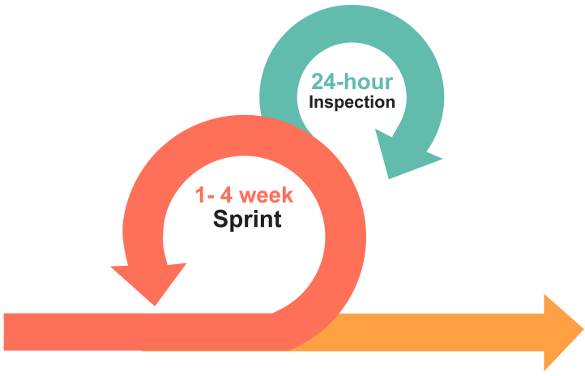








Testing in Scrum
Inputs from
Stakeholders,
Clients, Team
Burn-down/up
charts
Daily Stand-up
Meeting
Scrum Master
Product Owner
The Team
Emerging, prioritized functional
and non-functional requirements
Select Product Backlog Items
and prepare Sprint Backlog
Tasks, task estimates
and assignments
Sprint Review
Sprint Time-box and
Backlog items freeze
Increment of potentially
shippable functionality
Product Backlog
Sprint Planning Meeting
Sprint Backlog
Sprint Retrospective
Figure 6: Scrum process

Slide 15
Why should we automate testing?
Cost effectively
16 hours more to run tests
Manual testing is error prone
Notes:
Commit will trigger a build (small build) → trigger unit tests → etc.
Platform Tests includes Component Tests, Integration Tests and System Tests
Deploy to Staging = UAT
Why should we automate testing?

Slide 16
Unit Testing

Slide 17
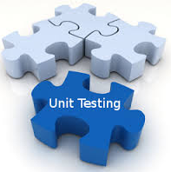
What is Unit Testing?
Is a level of software testing process where individual units/ components of a software/ system are tested.
The purpose is to validate that each unit of the software performs as designed.
A Unit Test is a block of code to test a small piece of functionality (the unit).

Slide 18
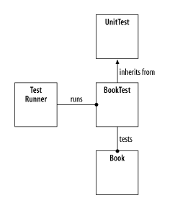

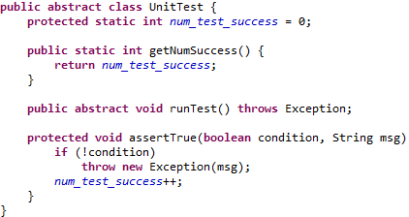
Example - Create a Book
Figure 7: Class diagram for the basic unit test framework
Notes:
We will create a representation of a book and its title

Slide 19

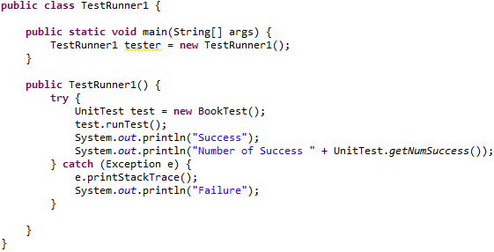
Example - Create a Book

Slide 20
When
Developing
Write tests first: Test Driven Development
Let your unit tests guide your development
Debugging – write tests to reproduce bugs before debugging and fixing them

Slide 21
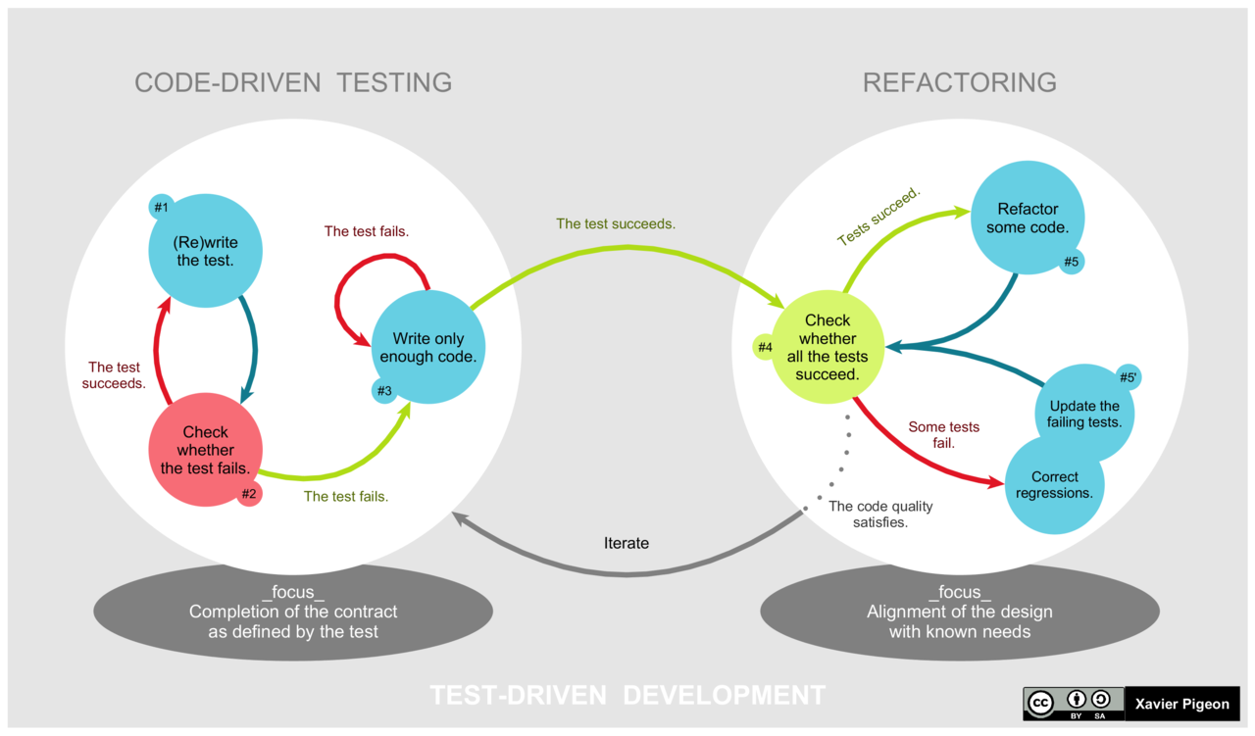
Test Driven Development
https://en.wikipedia.org/wiki/Test-driven_development#/media/File:TDD_Global_Lifecycle.png
Notes:
Refactoring means changing the internal structure of your code without changing the externally visible behaviour

Slide 22
Benefits
Living documentation and test of developer understanding
Lead/drive to better design
separate read-only and write methods
avoid code smells such as long classes, long methods, large conditionals
prefer composition to inheritance
dependencies/references injection instead of creating a new instance
We (people) make mistakes
Know how code works and when / where it’s broken
Easier code refactoring and maintenance: add new features, upgrade third-party libraries, help new members
Continuous Integration and Continuous Delivery
Fewer bugs.
Increasing returns.
Code coverage measurement
Notes:
Break down a user story into multiple smaller scenarios before implementing them
Manual testing makes mistakes. It’s impossible for a developer to all features that need testing after making a change to refactor, add new features, ore remove features.
The Science of TDD
The evidence says:
TDD can reduce bug density.
TDD can encourage more modular designs (enhancing software agility/team velocity).
TDD can reduce code complexity.
Says science: There is significant empirical evidence that TDD works*.

Slide 23
What to test?
public interface/methods of the class:
ensure that all your non-trivial code paths are tested (including happy path and boundary/edge cases)
Provide negative tests and verify exceptions thrown
Don’t need to test trivial code:
getters and setters
other trivial implementations (e.g. without any conditional logic)
Notes:
You cannot call private method of a class from the test class. Just test public API. If there is any private method that you would like to test it, it may be a complex method and you need to move it to a public method of a utility class.
Protected or package-private are accessible from a test class (given the package structure of your test class is the same as with the production class) but testing these methods could already go too far.

Slide 24
How to write good Unit Tests?
A good test is an abstraction of how client interact with the system
Keep unit tests small, fast and independent
Be fully automated and non-interactive
Verify that a known, fixed input produces a known, fixed output
Verify single unit of code and not the integration
One assertion per test method
Name tests properly – methodUnderTest_Condition_Result
Ensure that unit tests run completely in-memory
Use the strongest assertions possible
Notes:
Test code != production code: if we write production code first we usually write our tests that reflects the production code, e.g. using constants, follow the same steps. This will force our tests must be changed when refactoring code (not modify public APIs). The correct way is to write tests first to make our tests drive the implementation/ production code.
Tests run completely in-memory: no I/O (files, database) or network access (email)

Slide 25
How to write good Unit Tests? (cont.)
Put assertion parameters in the proper order: expected, actual
Ensure that test classes exist in the same Java package as the production class under test
Ensure that test code is separated from production code (Testing Behavior vs. Testing implementation)
Do not print anything out in unit tests
Do not initialize in a unit test class constructor; use an @Before method instead
Do not use static members in a test class
Do not use Thread.sleep in unit tests
Do not declare that methods throw any particular type of exception, just throw Exception
Write clean test code.
Notes:
Test code != production code: if we write production code first we usually write our tests that reflects the production code, e.g. using constants, follow the same steps. This will force our tests must be changed when refactoring code (not modify public APIs). The correct way is to write tests first to make our tests drive the implementation/ production code.
Tests run completely in-memory: no I/O (files, database) or network access (email)

Slide 26
Test Structure
Set up the test data
Call your method under test
Assert that the expected results are returned
Clean up / teardown (Optional)
Behavior-Driven Development style
Given: describes the state of the world before you begin the behavior you're specifying in this scenario.
When: executes the behavior that you’re specifying.
Then: describes the changes you expect due to the specified behavior.
Notes:
SUT = Subject under test, it could be a function, a method, a class, etc.

Slide 27
Test Structure (cont.)
Feature: User trades stocks
Scenario: User requests a sell before close of trading
Given I have 100 shares of MSFT stock
And I have 150 shares of APPL stock
And the time is before close of trading
When I ask to sell 20 shares of MSFT stock
Then I should have 80 shares of MSFT stock
And I should have 150 shares of APPL stock
And a sell order for 20 shares of MSFT stock should have been executed
Notes:
SUT = Subject under test, it could be a function, a method, a class, etc.
Executable Specifications By Examples
Living Documentation
Automated Tests

Slide 28
Java Unit Test Frameworks
Name | Description
JUnit | Testing tool default for Java
TestNG | A multi-purpose testing framework, which include unit tests, functional tests, and integration tests, even no-functional tests (as loading tests, timed tests). Easier to use than JUnit
DbUnit | A JUnit extension to perform unit testing with database-driven programs
Mockito | A famous mock framework for Java
JMockit | Open source framework and tests can easily be written that will mock final classes, static methods, constructors, and so on. No limitations

Slide 29
Unit testing with JUnit

Slide 30

Overview
A Java framework to write Unit Tests.
Most JDK versions or IDEs supported
Each method is run separately in a different instance
Notes:
http://www.tutorialspoint.com/junit/junit_quick_guide.htm
JUnit provides:
Assertions for testing expected results.
Test features for sharing common test data.
Test suites for easily organizing and running tests.
Graphical and textual test runners.
JUnit is used to test:
an entire object
part of an object – a method or some interacting methods
interaction between several objects

Slide 31
JUnit API
org.junit.* and org.junit.runner.* contains all the core classes and annotations.
# | Class Name | Functionality
1 | Assert | Contains a set of assert methods.
2 | @Test | Any classes that contain one or more public void methods with @Test annotation are test classes.
 | @RunWith(Suite.class) @Suite.SuiteClasses({}) | Works together to aggregate multiple test classes into one test suite that can be run together.
3 | Result | Collects the results of executing tests.
4 | JUnitCore | Used to execute tests in test classes or test suites from command line or programmatically.

Slide 32
Junit API – Bacis Annotations
# | Annotation & Description
1 | @Test The Test annotation tells JUnit that the public void method to which it is attached can be run as a test case.
2 | @Before Several tests need similar objects created before they can run. Annotating a public void method with @Before causes that method to be run before each Test method.
3 | @After If you allocate external resources in a Before method you need to release them after the test runs. Annotating a public void method with @After causes that method to be run after the Test method.
4 | @BeforeClass Annotating a public static void method with @BeforeClass causes it to be run once before any of the test methods in the class.
5 | @AfterClass This will perform the method after all tests have finished. This can be used to perform clean-up activities.
6 | @Ignore The Ignore annotation is used to ignore the test and that test will not be executed.
Notes:
If a Junit test method is declared to return “String”, the compilation will pass ok. But the execution will fail
If a Junit test method is declared as “private”, the compilation will pass ok. But the execution will fail

Slide 33
JUnit 4 – Lifecycle of standard tests
Parameter Resolver
parameter context
objects/ mocks
@BeforeClass
@Before
@Test
@After
@AfterClass
Class Test
Figure 8: Test lifecycle
Notes:
http://www.javacodegeeks.com/2014/11/junit-tutorial-unit-testing.html

Slide 34
Assert class
# | Methods & Description
1 | void assertNotEquals([String message,] Object expected, Object actual) Check that two primitives/ objects are equal
2 | void assertFalse([String message,] boolean condition) Check that a condition is false
3 | void assertTrue([String message,] boolean condition) Check that a condition is true.
4 | void assertNotNull([String message,] Object object) Check that an object isn't null.
5 | void assertNotSame([String message,] Object expected, Object actual) Check that two objects refer to the same object.
6 | void fail([String message]) Fails a test with or without message.
Notes:
Provides a set of assertion methods useful for writing tests. Only failed assertions are recorded.

Slide 35
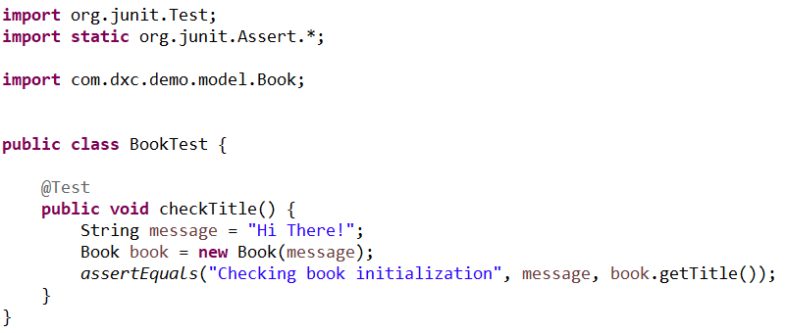
Test Class
Containing any public void methods with @Test annotation
Notes:
A TestSuite is a Composite of Tests. It runs a collection of test cases

Slide 36
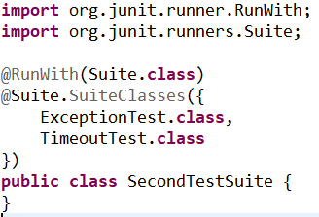
Test Suite
Aggregating multiple test classes into one test suite
Using two annotations to achieve this: @RunWith(Suite.class) and @Suite.SuiteClasses({})
Notes:
A TestSuite is a Composite of Tests. It runs a collection of test cases

Slide 37
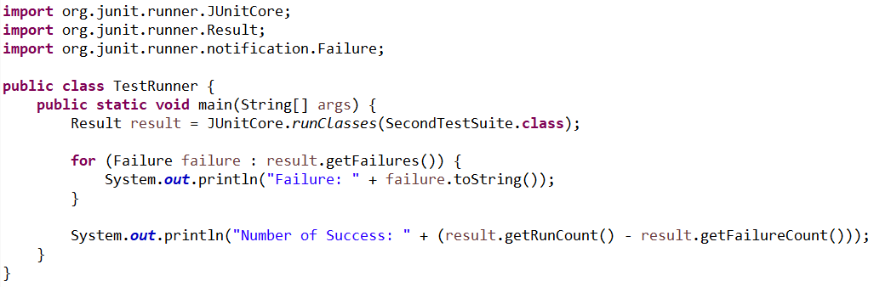
Test Runner
To execute tests in test classes or test suites
Notes:
A TestSuite is a Composite of Tests. It runs a collection of test cases

Slide 38
Demo
Will see in detail how to create and run tests and we will show how to use specific annotations and assertions of JUnit
Notes:
http://www.javacodegeeks.com/2014/11/junit-tutorial-unit-testing.html

Slide 39
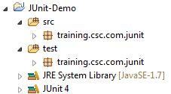
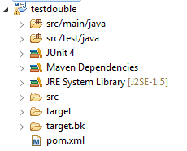
Junit in Eclipse

Slide 40
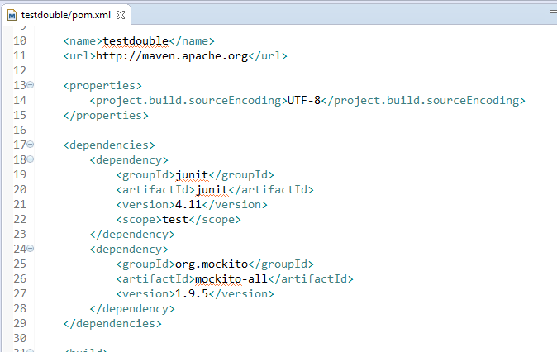
Junit in Eclipse

Slide 41
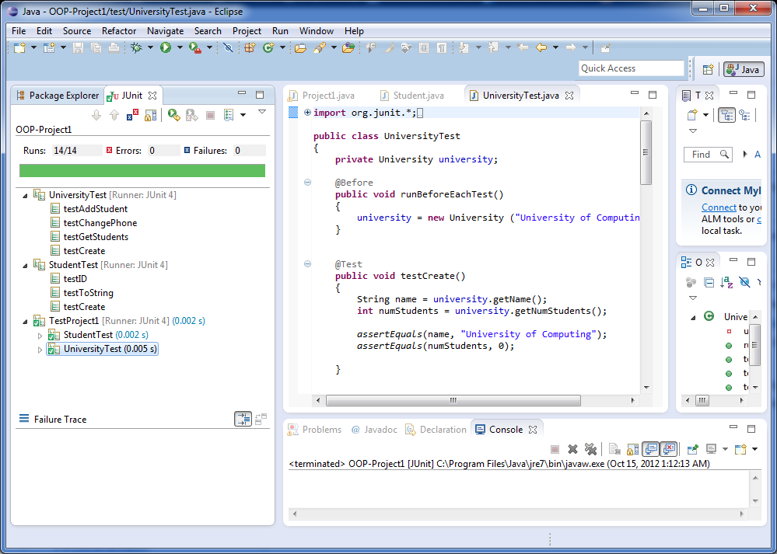
Junit in Eclipse

Slide 42


Advantages & Disadvantages
Advantages:
Quick to write / reuse test cases & test data
Easy manage tests of whole project
Asserts for contrast between expected and real output
Integrate with tools – Ant, Maven, IDEs
Disadvantages:
Unable to do dependency tests.
Not suitable for larger test suite.

Slide 43
Advance: Stub & Mock
Notes:
A unit test should test a class in isolation. Side effects from other classes or the system should be eliminated if possible. The achievement of this desired goal is typical complicated by the fact that Java classes usually depend on other classes
A dummy object is passed around but never used, i.e., its methods are never called. Such an object can for example be used to fill the parameter list of a method.
Fake objects have working implementations, but are usually simplified, for example they use an in memory database and not a real database.
A stub class is an partial implementation for an interface or class with the purpose of using an instance of this stub class during testing. Stubs usually do responding at all to anything outside what's programmed in for the test. Stubs may also record information about calls
A mock object is a dummy implementation for an interface or a class in which you define the output of certain method calls.

Slide 44
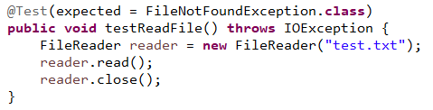
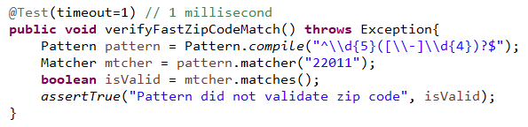
Handling Exception and timeout
Set expected parameter to an exception class
Set timeout parameter to a number of milliseconds
Notes:
Write a sample unit testing method for testing exception named as IndexOutOfBoundsException when working with ArrayList?
@Test(expected=IndexOutOfBoundsException.class) public void outOfBounds() { new ArrayList<Object>().get(1); }
Write a sample unit testing method for testing timeout?
@Test(timeout=100) public void infinity() { while(true); }

Slide 45
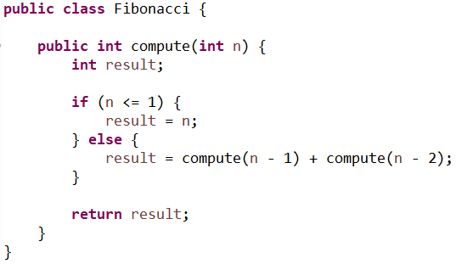
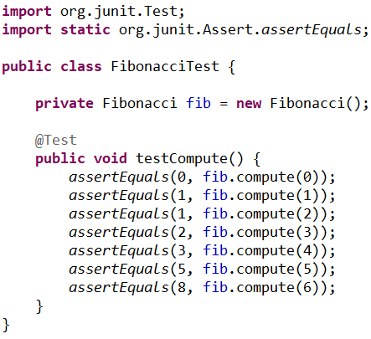
Parameterized Tests
Notes:
Write a sample unit testing method for testing exception named as IndexOutOfBoundsException when working with ArrayList?
@Test(expected=IndexOutOfBoundsException.class) public void outOfBounds() { new ArrayList<Object>().get(1); }
Write a sample unit testing method for testing timeout?
@Test(timeout=100) public void infinity() { while(true); }

Slide 46
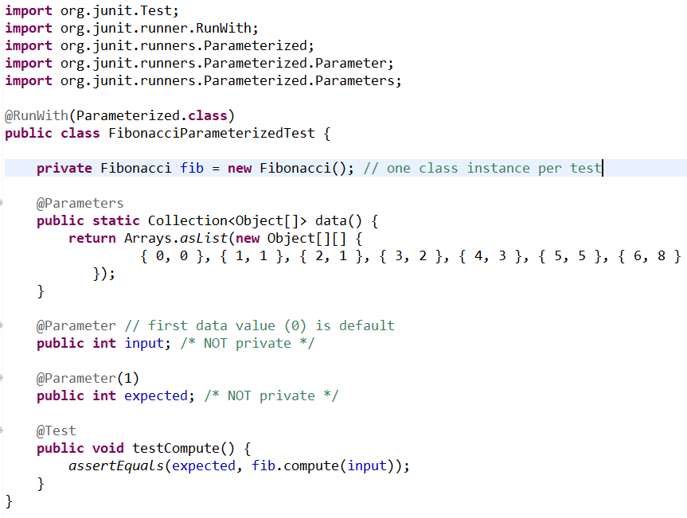
Parameterized Tests (cont.)
Notes:
Write a sample unit testing method for testing exception named as IndexOutOfBoundsException when working with ArrayList?
@Test(expected=IndexOutOfBoundsException.class) public void outOfBounds() { new ArrayList<Object>().get(1); }
Write a sample unit testing method for testing timeout?
@Test(timeout=100) public void infinity() { while(true); }

Slide 47
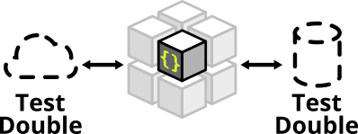
Test Doubles
Object that stands for a real object in a test.
Verify logic independently when code it depends on is not available or unusable
Avoid Slow Test.
Test Double
Dummy Object
Test Stub
Test Spy
Mock Object
Fake Object
Figure 9: Test Double variations
Notes:
A unit test should test a class in isolation. Side effects from other classes or the system should be eliminated if possible. The achievement of this desired goal is typical complicated by the fact that Java classes usually depend on other classes
A dummy object is passed around but never used, i.e., its methods are never called. Such an object can for example be used to fill the parameter list of a method.
Fake objects have working implementations, but are usually simplified, for example they use an in memory database and not a real database.
A stub class is an partial implementation for an interface or class with the purpose of using an instance of this stub class during testing. Stubs usually do responding at all to anything outside what's programmed in for the test. Stubs may also record information about calls
A mock object is a dummy implementation for an interface or a class in which you define the output of certain method calls.
A spy is like a mock, but it records its call. Email service that records how many messages it was sent.

Slide 48
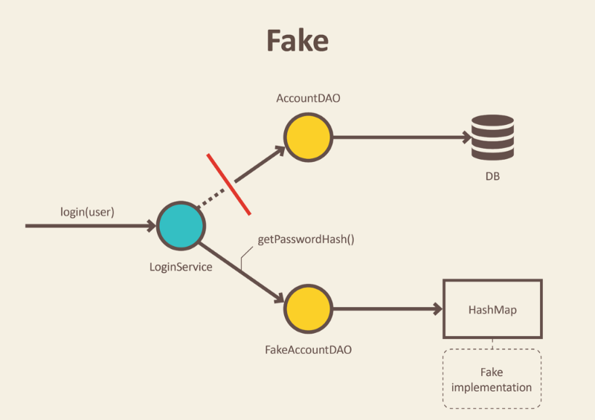
Fake
Notes:
http://engineering.pivotal.io/post/the-test-double-rule-of-thumb/
Use doubles to stand in for collaborating components in your tests:
Use a dummy to ensure a collaborator is never used in a certain scenario.
Use stubs to double read only collaborators.
Use spies to double write only collaborators.
Refactor a spy into a mock to dry up duplicate spy verification between tests.
Use fakes to double read/write collaborators, and write contract tests to verify their behavior.
Join these doubles together into new combinations when appropriate, but carefully weigh the tradeoffs when doing so

Slide 49
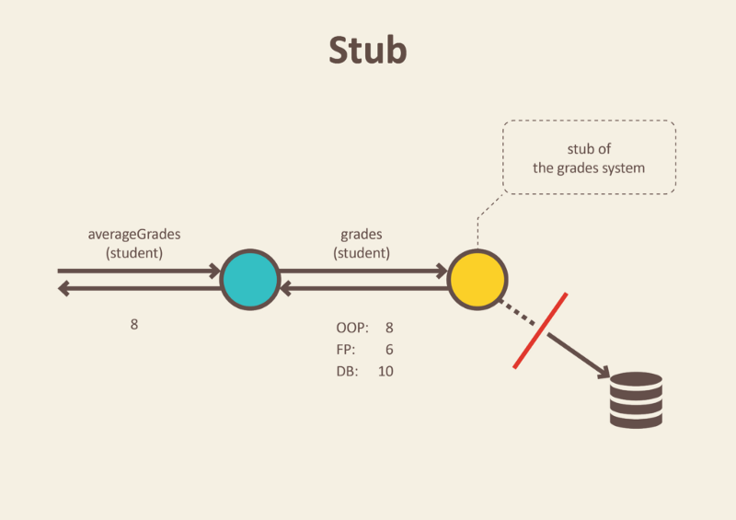
Stub
Notes:
http://spring.io/blog/2007/01/15/unit-testing-with-stubs-and-mocks/

Slide 50
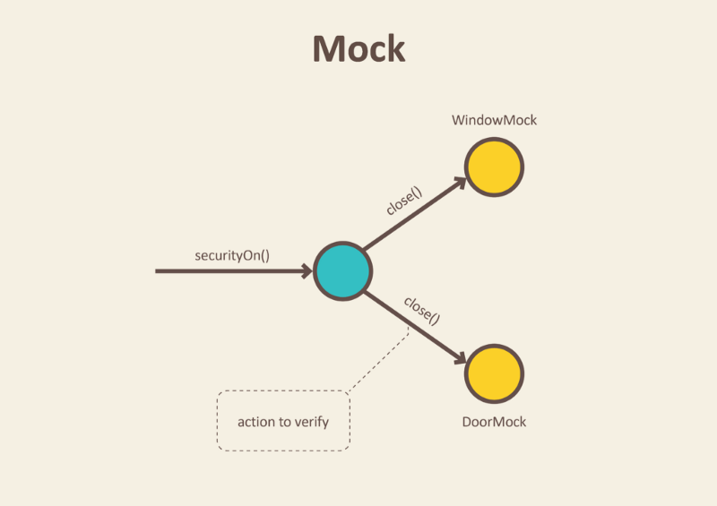
Mock
Notes:
http://spring.io/blog/2007/01/15/unit-testing-with-stubs-and-mocks/

Slide 51
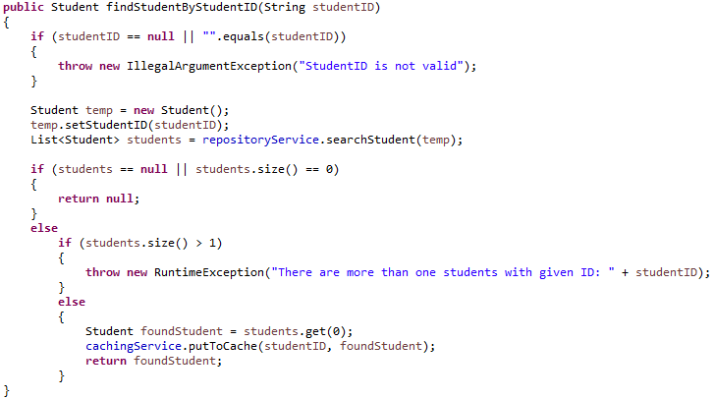
Test Stub
A variation of Test Double.
Verify logic independently when it depends on indirect inputs from other components.
Need a Stub here
Notes:
http://spring.io/blog/2007/01/15/unit-testing-with-stubs-and-mocks/

Slide 52

Mock Object
A variation of Test Double.
Verify logic independently when it depends on indirect inputs from other components.
Mock Object implements Behavior Verification for indirect outputs of the SUT.
Need a Mock here
Notes:
http://spring.io/blog/2007/01/15/unit-testing-with-stubs-and-mocks/

Slide 53
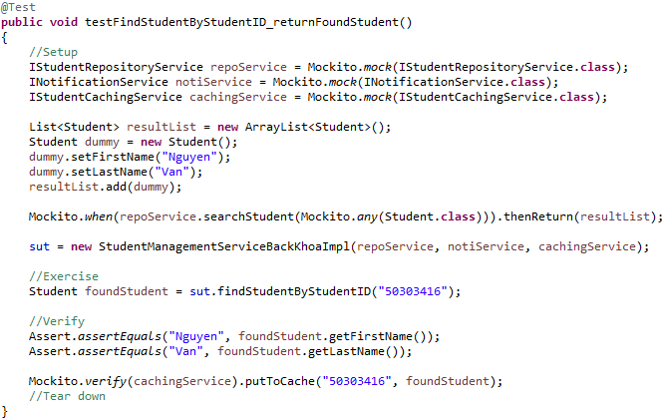
Mockito
Mocking framework
Create Test Double such as Dummy, Stub, Mock Object easily
Stub object
Dummy object
Mock object
Notes:
https://github.com/mockito/mockito

Slide 54
Summary
Software Testing
Test Driven Development
Unit Testing with JUnit
Stub, Mock and how to use
Get along with your friend

Slide 55
Questions & Answer

Slide 56
Thank You!

Slide 57
JUnit 5 vs JUnit 4 – Annotations
FEATURE | JUNIT 4 | JUNIT 5
Declare a test method: public void | @Test | @Test
Execute before all test methods in the current class | @BeforeClass | @BeforeAll
Execute after all test methods in the current class | @AfterClass | @AfterAll
Execute before each test method | @Before | @BeforeEach
Execute after each test method | @After | @AfterEach
Disable a test method / class | @Ignore | @Disabled
Test factory for dynamic tests | NA | @TestFactory
Nested tests | NA | @Nested
Tagging and filtering | @Category | @Tag
Register custom extensions | NA | @ExtendWith
Notes:
http://www.javacodegeeks.com/2014/11/junit-tutorial-unit-testing.html

Slide 58
Revision History
Date | Version | Description | Updated by | Reviewed and Approved By
Aug 2017 | 2.0 | Retheme with DXC template |  | Quang Tran
Oct 2018 | 3.0 | Add Test Driven Development and emphasize test first approach Add continuous integration and delivery processes and where unit testing is Upgrade JUnit version from 3.x to 4.x Update benefits of Unit Testing | Duong Le

